Slide 1

PES’s Modern College of Engineering, Shivajinagar, Pune-5. Department of Electronics and Telecommunication A.Y. – 2021-22
Project Title : Scrolling display using neopixel LED matrix
Names of the students :
1. Omkar Kashid (32042)
2. Madhuri Mahale (32050)
3. Shilpa Sanap (32069)
Mini-Project Coordinators
Dr. Mrs. V. P. Kodgirwar
Dr. Mrs. K. A. Adoni
Mr. Ramgopal Sahu

Slide 2
Introduction
Display advertising plays a very importing role in marketing and there are several advertisement methods like newspapers, posters, glow signboards, etc.
Digital LED display boards are getting popular nowadays because of their reliability and advantages.
Although they are a little bit expensive still they are durable and customizable, like the advertising text can be changed easily whenever needed and they can also be used as Digital Notice Board at any public place.
In our project we used LED strip of 300 led to control the text displayed over it and Scrolling LED neopixel matrix display is implemented by using microcontroller.

Slide 3
Literature Survey
Sr.No | Published Year | Author | Title | Method | Limitation
1 | 2007 | Prof. Simha Shreya Chethan Kumar, Parinitha C, Shashidhar | Accept SMS and display on the notice board | Input Text message gets displayed on LED | General Purpose LED Display. Fixed type display
2 | 2001 | Neeraj Khera, Divya Shukla, Shambhavi Awasthi | Simple and Low Cost Android Based Wireless Notice Board | Wireless Display Board using Android module | Use of android module makes the project costly And bulky

Slide 4
System Specification
Neo WS28128B :- LED Matrix
256 Brightness Display
16777216 Color full display
Scan frequency :-400Hz/s
Power supply:- 6.0 A , 12V
ATMEGA 328:- Prosser
DS1307:- Real Time Clock IC
USB to TTL Converter
PCB Board

Slide 5
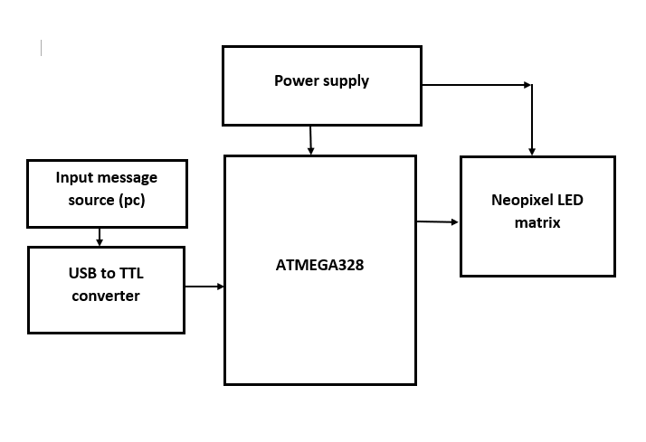
Block Diagram

Slide 6
Circuit Diagram

Slide 7
Working of project
After turn ON the power supply fix message get scrolling on the Led matrix display.
Take the text message from PC into input buffer of microcontroller through USB to TTL converter.
Microcontroller Convert this text message into Led matrix display format .
After conversion of text message into matrix format, Display it on LED matrix.
Fix image can be display or animated which is stored into microcontroller memory.

Slide 8
We can program each led separately with the help of fast led library we can create different animations and characters.
After uploading code to Atmega Microcontroller should use a 6.0-ampere power supply. Because at maximum brightness a neopixel led draws around 20 mA current. We have total 300 LEDs so 300*20=6.0 A.

Slide 9
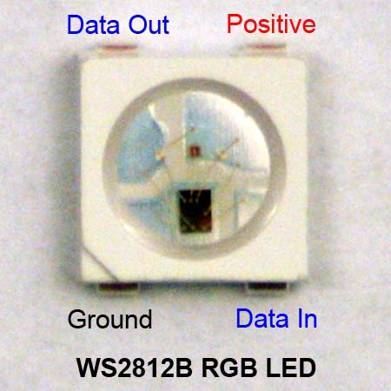
Each pixel of the three primary color can achieve 256 brightness display, completed 16777216 color full color display, and scan frequency not less than 400Hz/s

Slide 10
Applications
Educational Institution and Organization
Advertisement
Railway station
Hotels / Restaurants
Nursing homes
Bus routes
Wedding light
Clocks
Showing any kind of information in public places
Traffic Signal Light

Slide 11
Conclusion
.
This project is very suitable for small scale as well as medium scale information display.
This model can be used very efficiently in establishments like chain restaurants wherein the order and special discounts can be displayed at all branches simultaneously, in colleges wherein students and staffs can be informed simultaneously in no time.
It can be set up at public transport places like railways, bus station, and airport and also at roadside for traffic control and in emergency situations, and very easy to handle.
Microcontroller with niopixel led matrix can perform various scrolling pattern which are attractive as well as informative. Thus, this project is very suitable

Slide 12
Future Scope
In future we can add a speaker which will tell us what is showing on LED matrix Display for e.g:- If time is showing on display then it will tell through speaker.
In future we can make it wireless using NodeMCU or Wifi , Blutooth for sending code through any system to Product.
Also we can make rolling display or folding display which will be easy to transport and take less space or efforts.

Slide 13
References
[1] Jeena Joy, Athira Poovathody, Athul R S, Athul Subran, Basil Paul, Implementation of Digital Dice Game‖, Professor, Dept. of EEE, Mar Athanasius College of Engineering, Kothamangalam1 UG Student, Dept. Of EEE, Mar Athanasius College of Engineering, Kothamangalam, India2, 3, 4, 5, Vol. 3, Issue 2, February 2014.
[2] Harold Thimbleby FIT Lab Interaction Laboratory, Swansea University, Don’t use seven segment displays‖ Swansea, Wales. p- 1-6
[3] Pang, GKH; Chan, CH; Kwan, TTO, Tricolor lightemitting diode dot matrix display system with audio output‖, IEEE TRANSACTIONS ON INDUSTRY APPLICATIONS, VOL. 37, NO. 2, MARCH/APRIL 2001 , p.534-540.

